Slide 1

PR282 JAVA SOKOBAN
JAMES GABIANA FINAL PRESENTATION
STUDENT ID 11981342

Slide 2
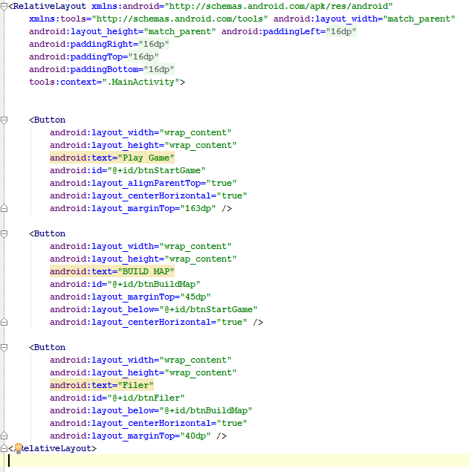
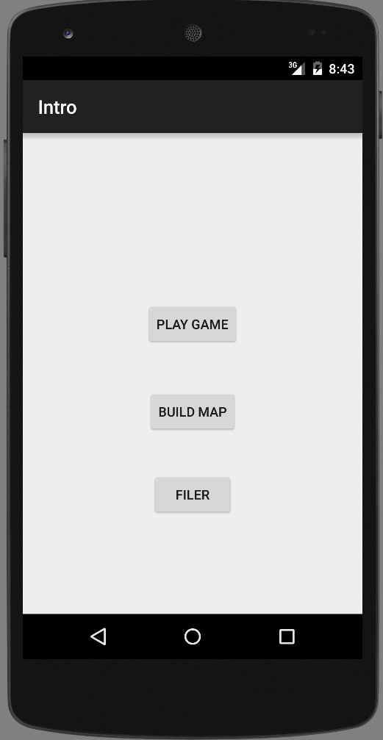
This is the first page of my application
User has a choice to play the game, build the map, or zip file

Slide 3
MoSoCow for the Game
MoSoCow Must Draw maze maze should be centered draw walls draw player draw floor draw target draw box on floor draw box on target build a controller have movement controls in each main direction on screen elements must update in the model when updated on screen Should have swipe movement main menu or context menu that allows restarting connecting app to filer work on multiple display types (watch phone tablet) Could smooth transitions for moving elements update turn counter each move Nice to have sound effects game over screen/toast prompts for new game upon level end
What I implemented
MUST Draw maze maze should be centered draw walls draw player draw floor draw target draw box on floor draw box on target build a controller have movement controls in each main direction on screen elements must update in the model when updated on screen Should main menu or context menu that allows restarting work on multiple display types (watch phone tablet) Nice to have game over screen/toast(Congratulate the player)

Slide 4
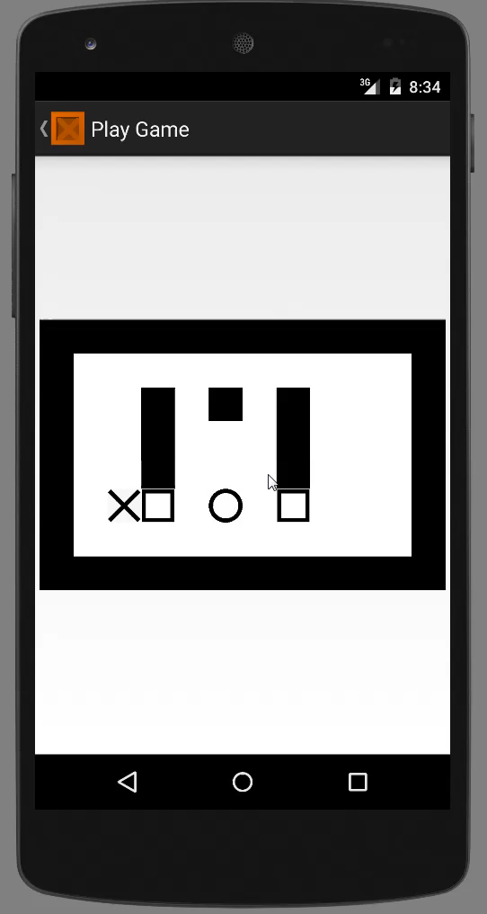
Playing the game Video
It is a bit slow when running the game in emulator but it works great on real android device.
Click Play
Video
Notes:
Click to play the video

Slide 5
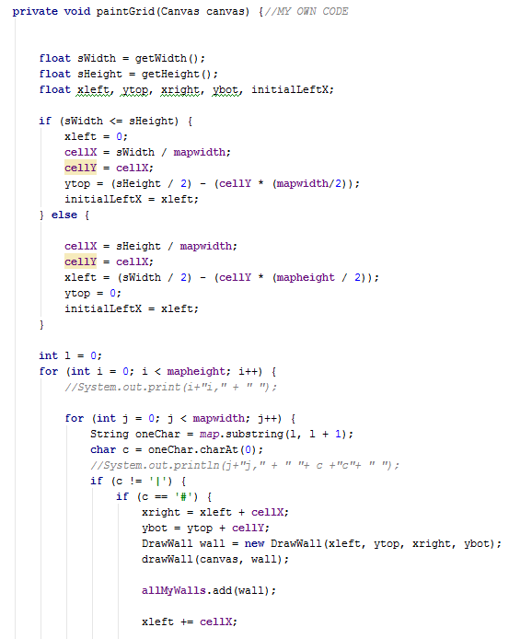
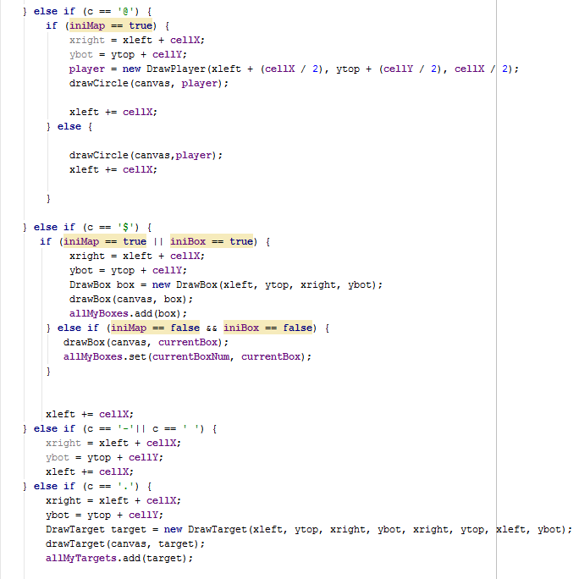
Code for drawing the maze
These are my own code
Notes:
In Shapes.java class, I have a method called paintGrid (Canvas canvas) which has a parameter type Canvas. This method is responsible for creating different instances of cells(box, player, target, floor etc..) and storing all those instances on arrays list. I can then access each element of array and get the properties of a particular cell and then change the value of the property to move a a cell(player and boxes).
I have a global variable called mapwidth and mapheight which is the value of rows(width) and height(column). I then made a condition which calculate the value of width and height of a cell(cellX, cellY); The size of a cell is very DYNAMIC, the size depends on how big the screen is and how big the map is, and all elements are calculated to fit the map perfectly on the screen.
If a substring on the variable map matches a particular character inside the method, for example it matches # which is wall , then it will make an instance of the DrawWall class and set properties of that instance, call the method drawBox, and store that new element to the allMyBoxes array.

Slide 6
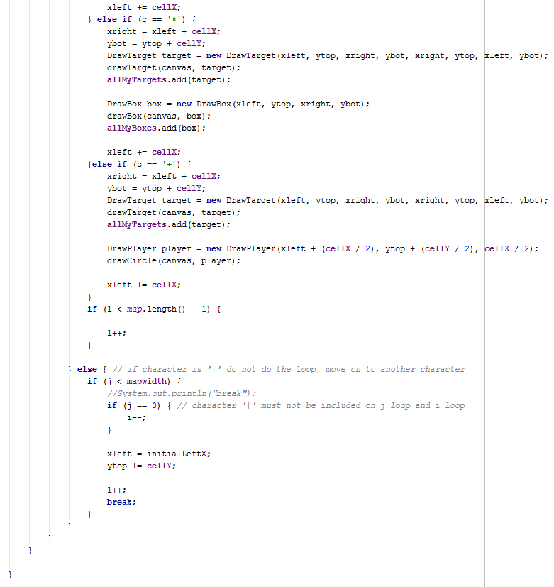
Code for drawing the maze continues…
Notes:
The last chunk of code at the bottom of the method is where it knows that a new line has been created because of the character “|”. It will then set the int ‘i’ variable one step back to compensate for the value that the new line made.

Slide 7
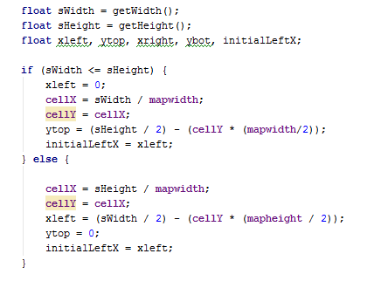
Code for maze should be center
These are my own code
Notes:
This chunk of code is responsible for drawing the map on the center, no matter what the size of the map or the screen. This allows cells to be very dynamic.
First get the size of the screen using the getWidth() and getHeight() methods and then set them on a variable type float.
If the screen is portrait (not rotated), then set the width of the cell base on the width of the screen, otherwise base it other way around;
First calculate the middle of the screen(x) to get the value of cellX, then calculate the middle(y) and add half of the height of the map to it based on the value of cellX to get the top left corner of the map.
Once you get the value of the top left corner position of the map, then you can put the map on the center.

Slide 8
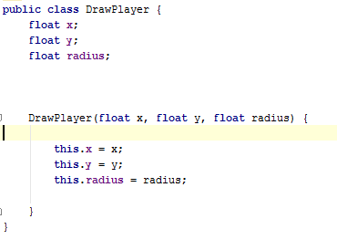
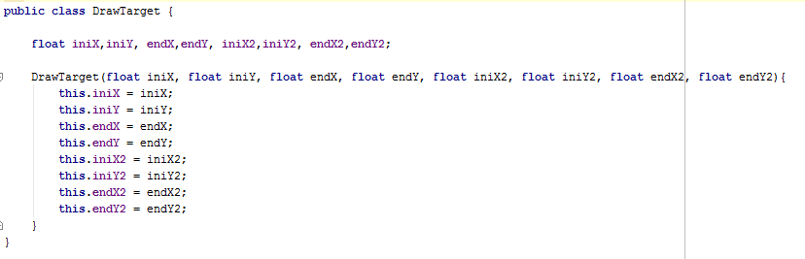
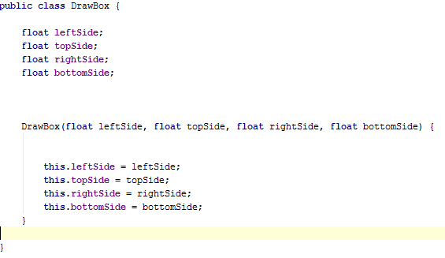
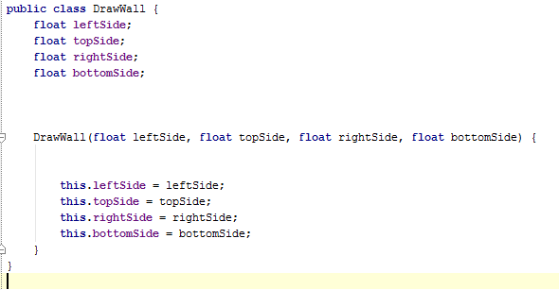
Code for draw wall, draw player, draw floor, draw target, draw box on floor, draw box on target.
These are my own code
Notes:
This are the Classes that I used to build the map and the game. I call all these Classes inside the Class Shapes.

Slide 9
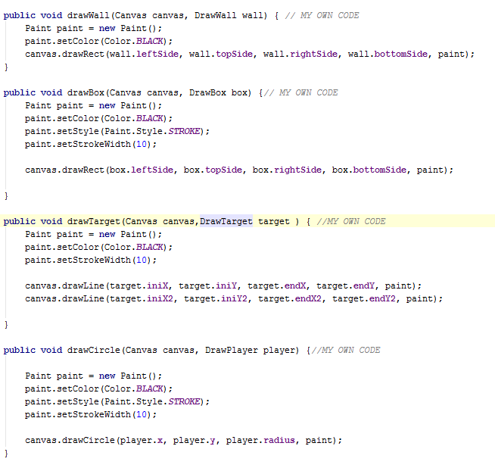
Code for draw wall, draw player, draw floor, draw target, draw box on floor, draw box on target continues…
These are my own code
Notes:
This chunk of code are methods from Shape class.
Each method takes parameter type class and gets the property of an object created to be used in drawing the cell on the map.

Slide 10
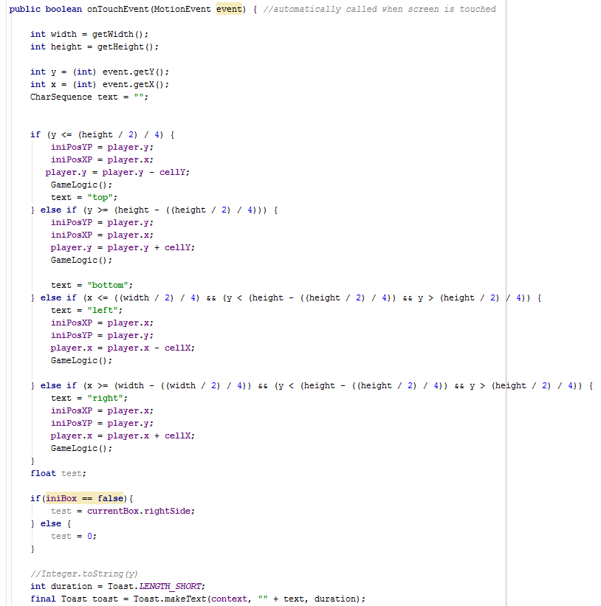
Code for Build a Controller, have movement controls in each main direction on screen elements must update in the model when updated on screen
These are my own code
Notes:
This method return a Boolean equal to false and automatically called when screen is touched. If screen is pressed on a particular direction, for example if the screen is touch on left, the player with/without the box will go on left and call the GameLogic() method which calculate the new location of the player or/and the box if it is touching the player.
This method also assigned value to the initial position of the player on the map.
This method returns false to stop the method from continually moving the player when finger is on holding/touching down the screen. It allows the player to move one step per finger tap.

Slide 11
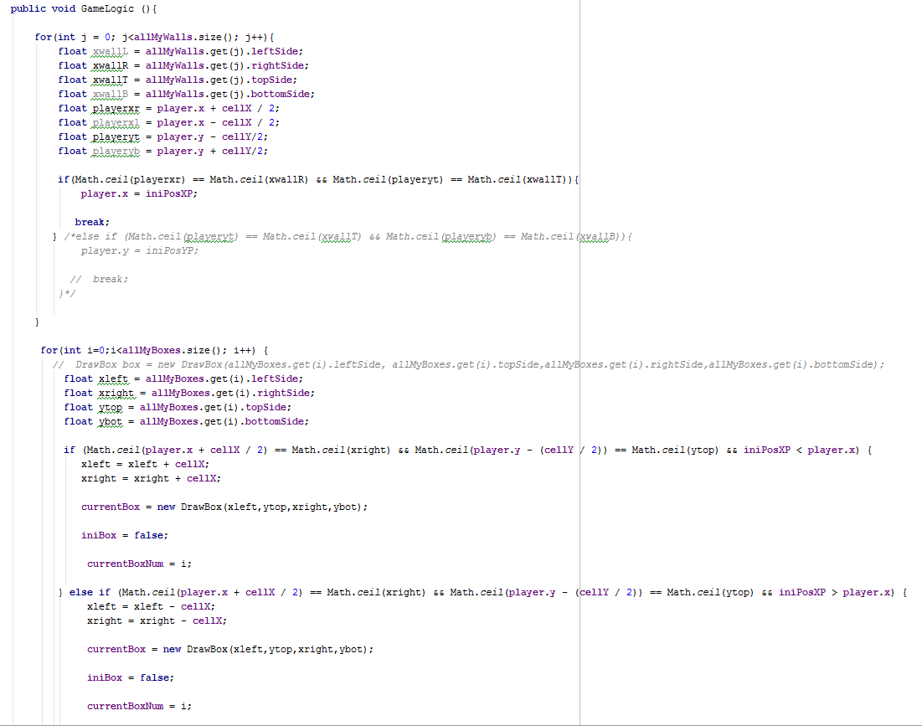
Code for Build a Controller, have movement controls in each main direction on screen elements must update in the model when updated on screen continues….
These are my own code
Notes:
This method is responsible for the game logic(stop player and boxes from going through walls, position of player, boxes, end of game, movements).
First I create a loop, which scans all the walls, boxes, targets on the map. If an instance of a class DrawWall is touching the player(the same position), then stop the player from moving, set the position of the player to initial position not the new position, redraw the player on the map.
And then go for another loop, which scans all the boxes on the map. If an instance of a box is touching the player and the player moves on a particular direction, then also move the box to that direction if its not touching a wall or another box.
Redraw all the elements affected on the map.
To make sure that the position of the elements matches exactly the position of other elements(player position, boxes, walls). I converted the variable float to a whole number(without the decimals). I used a method called ceil which is inherited from the Math class and converts the number to the higher value for example if number is 5.1 then it will convert it to 6. This allows elements to match exactly the position of others.

Slide 12
Building the map(Designer) MoSoCow
Must Have:
Can enter number into textbox to set height
Can enter number into textbox to set width
Click button to save map
Click button to load map
Click button to select tile
Click on map to set cell
Click button to create new map
Swipe left to bring up menu
Enter string into textbox to set map name
Click button to wipe map
Should Have:
Drag to place multiple tiles
Pinch to Zoom
Confirms wiping of map
Flip map on device orientation change
Click button to check map is valid
Could Have:
Select theme (Tileset)
Long press to show tile menu
Shake to wipe map
Click button to Undo last move
What I Implemented
Must Have: 4/10
Can enter number into textbox to set height
Can enter number into textbox to set width
Click button to load map
Click button to create new map
Should Have: 1/5
Flip map on device orientation change
Could Have:

Slide 13
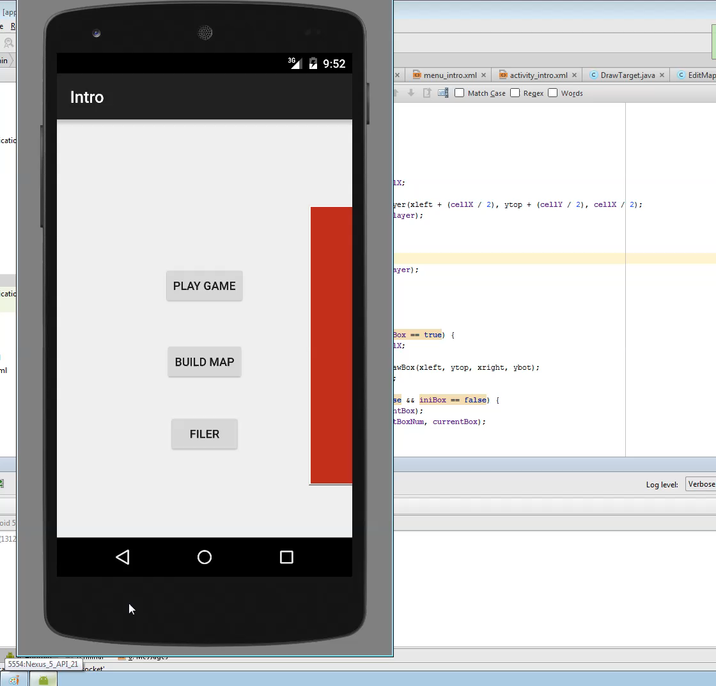
Building the map Video
Click Play
Notes:
Click to play the video

Slide 14
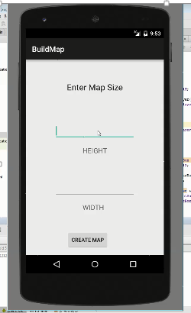
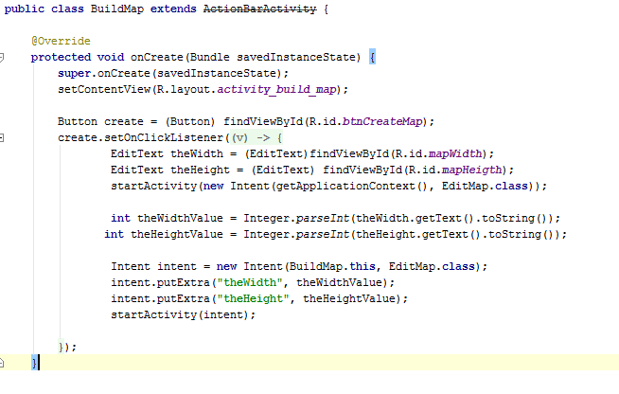
Code for Can enter number into textbox to set height, Can enter number into textbox to set width
Notes:
This code will get the users input for the width and height of the map, which then takes the data to another activity(the Edit map activity).

Slide 15
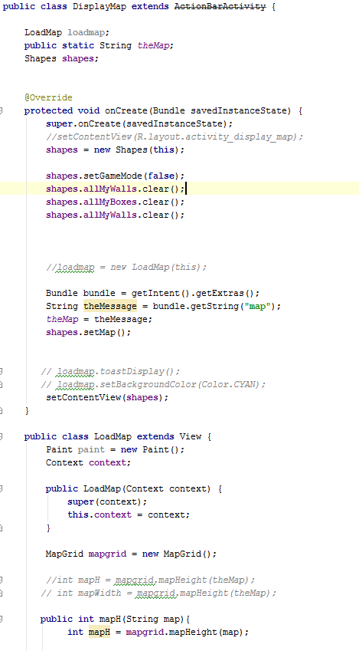
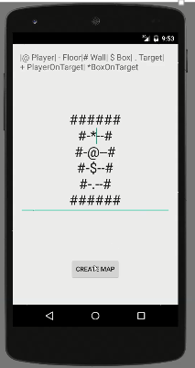
Code for Click button to load map and to create new map
These are my own code
Notes:
This code will clear all the cells array. And create and displays a map based on the characters on the screen(user input).
It will then get the data that the user input on the screen and be usable by other classes(Shapes class).
It will also set the Boolean variable called isGamemode to false, to tell the Shapes class that the user created a map and load only that map(not the default map).

Slide 16
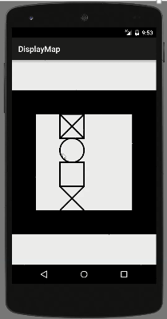
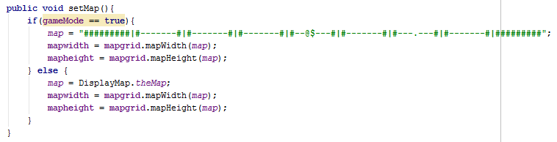
Code for Click button to load map and to create new map continues…
These are my own code
Notes:
This will set the map to either the default map or the map that the user created.
It will then set the global variables mapwidth and mapheight.

Slide 17
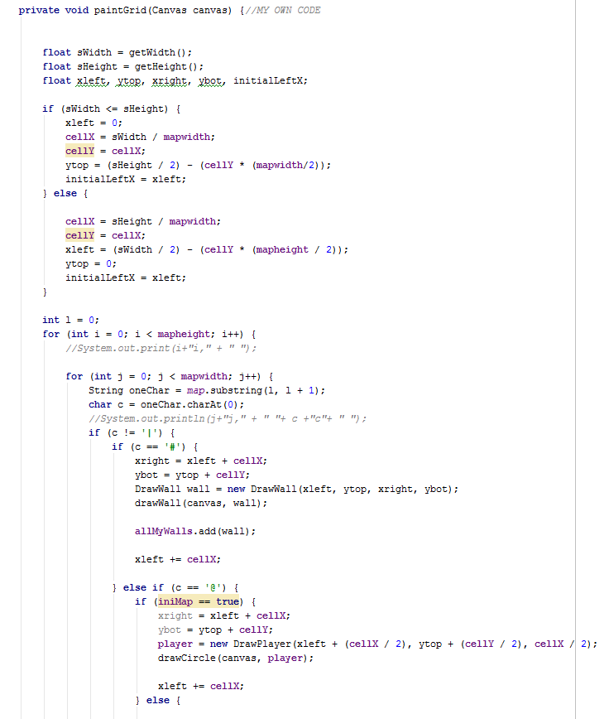
Code for Click button to load map and to create new map continues…
These are my own code
Notes:
In Shapes.java class, I have a method called paintGrid (Canvas canvas) which has a parameter type Canvas. This method is responsible for creating different instances of cells(box, player, target, floor etc..) and storing all those instances on arrays list. I can then access each element of array and get the properties of a particular cell and then change the value of the property to move a a cell(player and boxes).
I have a global variable called mapwidth and mapheight which is the value of rows(width) and height(column). I then made a condition which calculate the value of width and height of a cell(cellX, cellY); The size of a cell is very DYNAMIC, the size depends on how big the screen is and how big the map is, and all elements are calculated to fit the map perfectly on the screen.
If a substring on the variable map matches a particular character inside the method, for example it matches # which is wall , then it will make an instance of the DrawWall class and set properties of that instance, call the method drawBox, and store that new element to the allMyBoxes array.

Slide 18
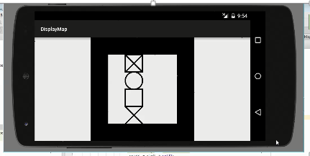
Code for Flip map on device orientation change
These are my own code
Notes:
This chunk of code is responsible for drawing the map on the center, no matter what the size of the map or the screen when rotated. This allows cells to be very dynamic.
First get the size of the screen using the getWidth() and getHeight() methods and then set them on a variable type float.
If the screen is portrait (not rotated), then set the width of the cell base on the width of the screen, otherwise base it other way around;
First calculate the middle of the screen(x) to get the value of cellX, then calculate the middle(y) and add half of the height of the map to it based on the value of cellX to get the top left corner of the map.
Once you get the value of the top left corner position of the map, then you can put the map on the center.

Slide 19
Summary of marks expected(GAME)
What I implemented in Game MUST 12/12
Draw maze maze should be centered draw walls draw player draw floor draw target draw box on floor draw box on target build a controller have movement controls in each main direction on screen elements must update in the model when updated on screen Should 2/4 main menu or context menu that allows restarting work on multiple display types (watch phone tablet) Nice to have 1/3 game over screen/toast(Congratulate the player)
MUST
I think I should get perfect mark for the must have features because I implemented all of them and they all works.
SHOULD
I think I should get half the mark for should because I only implemented half of them and they work.
NICE TO HAVE
I think I should get 1/3 the mark here because I only implemented 1/3 and the feature works.

Slide 20
Summary of marks expected(Designer)
MUST
I think I should get 4/10 mark because I only implemented 4/10 of the required must features.
What I Implemented
Must Have: 4/10
Can enter number into textbox to set height
Can enter number into textbox to set width
Click button to load map
Click button to create new map
Should Have: 1/5
Flip map on device orientation change
Could Have:
SHOULD
I think I should get 1/5 marks for the should features because I only implemented one, and that feature works

